Slide 1

Java Basics
Week 3 / 3

Slide 2
Last time’s quiz
It’s time to practice loops! Try to use both for and while loops for the following exercises:
Print numbers from 1 to 10.
Print the sum of all elements in an array of integers.
Make your own array with at least 5 of your favorite integers
Print the maximum value in an array of non-negative integers.
Make your own array with at least 5 of your favorite integers >= 0
Print the INDEX of the maximum value in an array of non-negative integers
Make your own array with at least 5 of your favorite integers >= 0
THINK: would it be possible to use an enhanced for loop for this problem?

Slide 3
Reviewing Last Week

Slide 4
Reviewing Changing Variables
Here are the most common arithmetic expressions for changing variables:
Division
Multiplication
Subtraction
Addition
Modulo
Just remember, whenever you need help:
DM SAM
public class Main {
public static void main(String[] args) {
int x = 69;
x /= 10;
x %= 10;
x -= 10;
x += 10;
x *= 10;
}
}

Slide 5
Reviewing Variables
What are variables?
You can assign data/values to variables.
You can initialize variables by stating its data type and the variable name.
Once you initialize a variable, you can assign a value to it via an equal sign.
Easy way to remember some of the most important data types:
Double
Int
Boolean
String
public class Main {
public static void main(String[] args) {
int x;
x = 694;
}
}

Slide 6
Comparison Operators
Comparison operators allow you to compare numeric expressions. The equality comparison also works on booleans.
Operator | Description | Example
== | equal | 1 == 2 // false false == false // true
!= | not equal | 1 != 2 // true false != true // true
<, <= | less than, less than or equal to | -10 < 0 // true -10 <= 0 // true
>, >= | greater than, greater than or equal to | 10 > 0 // true 10 >= 0 // true

Slide 7
Logical Operators Review
Logical operators relate boolean expressions together.
Operator | Description | Example
! | not inverses value | !true // false
&& | and true if both statements are true | true && true // true
|| | or true if at least one statement is true | true || false // true
== | equal | 1 == 2 // false false == false // true
!= | not equal | 1 != 2 // true false != true // true

Slide 8
Reviewing If Statements
if (boolean) {
code
}
What are else if statements?
Like if statements, else if statements only run if a condition is true AND if the preceding if/else if statements didn’t run
What are else statements?
Else statements are blocks of code that only run if all previous if and else statements didn’t run
public class Main {
public static void main(String[] args) {
int age = 10;
if (age < 5) {
System.out.println("baby");
}
else if (age < 18) {
System.out.println("child");
}
else {
System.out.println("on death bed");
}
}
}

Slide 9
Reviewing Conditionals
Not
And
Or
Equal
Not equal
Less than
Greater than
public class ConditionalReview {
public static void main(String[] args) {
int a = 0;
int b = 4;
int c = 5;
int d = 0;
System.out.println(a > 1); // false
System.out.println(a == d); // true
System.out.println(a == 0 && d == 0); // true
System.out.println(c >= 5); // true
System.out.println(b != 0); // true
}
}

Slide 10
Reviewing For Loops
For loops are loops that may have 3 statements inside:
Variable initialization
Conditional expression
Variable incrementation/decrementation
There must be a semicolon after the variable initialization and conditional!
If you do not include one of the first two expressions, you still need to have a semi-colon to show that the statement is not there.
public class Main {
public static void main(String[] args) {
for (int i = 0; i < 100; i++) {
System.out.println(i);
}
}
}

Slide 11
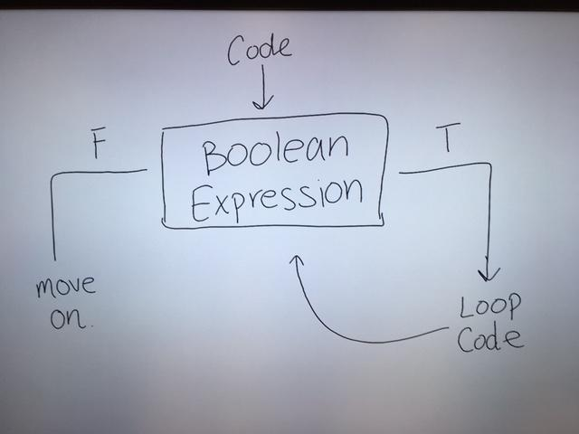
Looping Reviewed - continued

Slide 12
Functions

Slide 13

Functions
Until now, we have been writing all of our code inside of what’s called the “main function”.
This has been effective for our purposes, however when writing more complex programs, it can become very long and hard to read.
Functions allow us to break the code into smaller “subprograms,” which can exist outside of the main method
Java functions also allow us to group code together so that it can be reused.

Slide 14
Function pseudo code
When executing code in Java, it starts executing line by line in the main function.
The flow of a program with functions:
code1 will be executed first as we expect
At call myFunction java will leave the main function and go to the specific function that is called.
The code3 inside the function is executed
Java returns to the main function at call myFunction and executes code2
public class Example {
public static void main(String[] args) {
code1
call myFunction
code2
}
myFunction {
code3
}
}
Notes:
Make sure to clarify that its pseudocode

Slide 15
Writing functions in Java
Here is an example of the same program as we had in the last slide but with Java code:
public class Example {
public static void main(String[] args) {
System.out.println("An encrypted message: ");
encryptedMessage();
System.out.println("GAME OVER");
}
public static void encryptedMessage() {
System.out.println("A Myles le gusta la comida");
}
}
Notes:
lol

Slide 16
Function syntax
Syntax:
returnType - datatype of the output
void means nothing returns
functionName - can be anything, like a variable name)
function code - The actual code that is executed when the function is called
public static returnType functionName() {
// function code
}
Notes:
Explain that our last function as VOID because it doesn’t RETURN any value to where it came from. We printed something to the screen however never returned anything.
Explain function calls

Slide 17

Parameters
In Java, we can pass values into our functions.
These values that a function can accept are called parameters.
A function takes values and does things with them and then often times returns a value based on them.
A function can have any number of parameters (including none!)
When calling a function, arguments are listed with commas separating each one
Ex. function(1, 2, 3);
public class Hello {
public static void main(String[] args) {
printInfo("Ball Motor", 3.0);
}
public static void printInfo (String motor, double speed) {
System.out.println(motor + ": " + speed);
}
}
// outputs Ball Motor: 3.0

Slide 18
Return
A function can produce an output.
We use the return keyword in order to give back this output.
The type that is returned is specified in the function declaration (Ex. int sum(int a, int b))
If you do not want to return anything, then you can use void as the return type.
public class Example {
public static void main(String[] args) {
int sum = sum(1, 1); // 2
System.out.println(sum); // prints sum
}
public static int sum(int a, int b) {
return a + b;
}
}
Notes:
Talk about how the invocation is replaced by whatever is returned by the function.
Do the averageOfTwo example.

Slide 19
Syntax cheat sheet
Syntax:
returnType - datatype of the output (if any)
void means nothing returns
functionName - can be anything, like a variable name)
type param- A “parameter” is a variable that is given to a function (e.g. |x|, sqrt(x))
function code - The actual code that is executed when the function is called
public static returnType functionName(type param1, type param2) {
// function code
}
Notes:
Explain that our last function as VOID because it doesn’t RETURN any value to where it came from. We printed something to the screen however never returned anything.

Slide 20
POP QUIZ PART 1
It’s time to practice functions! Try to use functions for the following exercises:
Create a function that returns true only if an integer parameter is even
Create a function that takes in an array of integers and prints its values separated by spaces
Hint: System.out.println() adds a new line at the end
You can use System.out.print() to avoid this

Slide 21
Answers - I
Create a void function printArray(), with an arr parameter with type int[]
We will loop through the array and print the element with a comma appended to it
We will call printArray() in our main method
public class Answer {
public static void main(String[] args) {
int[] myArr = { 1, 2, 3, 4, 5 };
printArray(myArr);
}
public static void printArray(int[] arr) {
for (int i : arr) {
System.out.print(i + " ");
}
}
}

Slide 22
Answers - II
Remember, the percent (modulo) symbol in Java means remainder, so n%2 yields the remainder when dividing n by 2.
Thus, if n%2 is 0, the integer is even.
The return type is boolean because we are answering the question of “is it even” (hence the name isEven) which can only return true or false
public class AnswersFuntions {
public static boolean isEven(int n) {
return n%2 == 0;
}
public static void main(String[] args) {
System.out.println(isEven(3));//false
System.out.println(isEven(128));//true
}
}

Slide 23
POP QUIZ
It’s time to practice functions! Try to use functions for the following exercises:
Create a function that takes in a start and end integer and returns an array of integers that contains every value in between (inclusive).
Create a function that takes in a double base and an integer exponent and returns (base^{exponent})

Slide 24
Answers - III
Create a void function getRange(), with start and end integer parameters
Similar to question 1 of the looping exercises, we will loop through the range and print the number
We will call getRange() in our main method
public class Answer {
public static void main(String[] args) {
printArray(getRange(1, 10));
}
public static void printArray(int[] arr) {
for (int i : arr) {
System.out.print(i + ", ");
}
}
public static int[] getRange(int start, int end) {
int length = end - start + 1;
int[] range = new int[length];
for (int i = 0; i < length; i++) {
range[i] = i + start;
}
return range;
}
}

Slide 25
Answers - IV
An exponent is just repeated multiplication, so direct translation to a loop will work
To start, create an output value that will store the repeated operations and that will be returned
while (exponent > 0) and exponent--; will count exponent times, but a loop that counts up from 0 to exponent is also valid
The function’s return type is double because we are multiplying a double (the base) against another double
public class AnswersFuntions {
public static double pow(double base, int exponent) {
double output = 1.0;
while (exponent > 0) {
output *= base;
exponent--;
}
return output;
}
public static void main(String[] args) {
System.out.println(pow(3.0, 3)); // 27
System.out.println(pow(2.0, 6)); // 64
}
}

